Slide 1

Final Design Review Navigation and Automatic Steering System
Team Titan Scrum
Annamalai Arumugam –PO
Nitish Lele - SM
Vinay Manish Shah
Kishore Shankar Abhimanyu
Hetal Patel
Keshav Lingala
Sneha Priyadarshan
Thomas Tran
Benjarit Hotrabhavananda

Slide 2
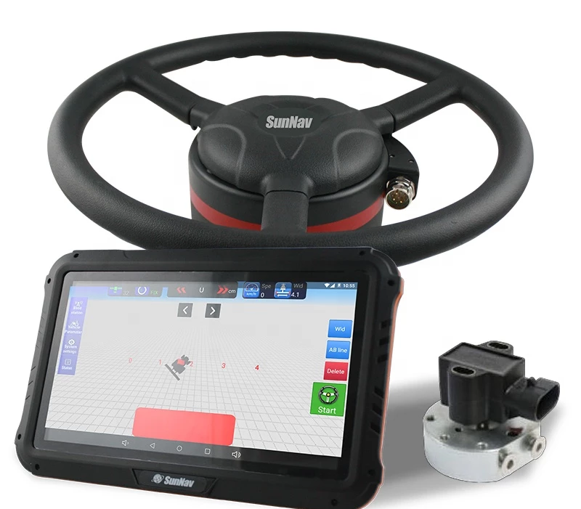
Introducing
The Smart Titan Navigation and Steering System (STNSS)

Slide 3
How did we decide to develop the design:
We decided to develop the design by considering the requirements of the navigation and automatic steering system given.
We studied the existing navigation and steering systems and identified the different components required to make a successful system. We then evaluated the different components flaws in the architecture and decided on the best combination of components that would meet the requirements of the system.
We considered all the functional requirements and non-functional with equal weightage.
We also considered the cost, performance and scalability of the components to ensure that the system was effective and could handle large amounts of data.
We developed a detailed design plan that included the system architecture, the interfaces, the software components, and the hardware components. This design plan was used to guide the development process and ensure that the system met the requirements.

Slide 4
How did we decide to develop the design:
Main key functional components considered:
Position & Velocity
Route Selection & Driver controls
Steering
Obstacle avoidance & Emergency actions.
Main key Non-functional components considered:
Availablity
Reliablity
Security
Portablity

Slide 5
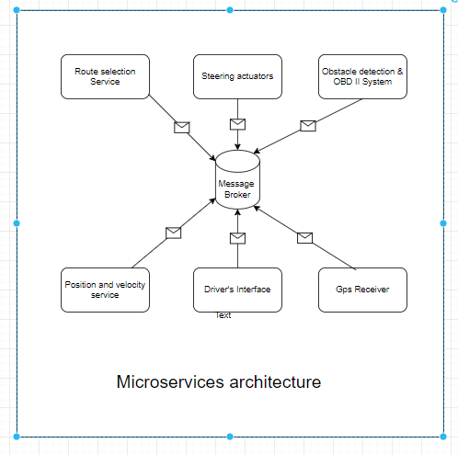
Our high-level microservices based product architecture
1. Implementing using microservices architecture, since navigation controller is the main process which need to run in a synchronized fashion.
2. We plan to use cockroach message broker which is a MQTT protocol-based messaging broker and queues can be created for each module.
3. Each module can act as a producer and consumer such that It can publish message and consume on the other end.
Controller

Slide 6
How We divide our work and time
Brainstorming Session: The first step in our process was to have a brainstorming session to generate ideas for the Software Architecture Document. During this session, the team discussed the objectives of the project and generated various ideas for the design of the Navigation and Automatic Steering System.
Define System Requirements: After the brainstorming session, the team created a list of system requirements for the Navigation and Automatic Steering System. This list included performance requirements, user interface requirements, and other technical requirements.
Design Document: The next step was to create a detailed design document that described the overall system architecture. This document included diagrams and other visuals that explained the components of the system, the data flow between components, and the interactions between components.

Slide 7
Challenges We Faced as a team
Complexity of the System: The Navigation and Automatic Steering System is a complex system that requires the integration of several components and technologies. This complexity can make it difficult to properly plan, design, and develop the system.
Identifying and understanding the system requirements.
Developing an appropriate system architecture that meets the requirements.
Developing a detailed software architecture that includes components, services, and their interactions.
Designing the software components to be modular and reusable.
Ensuring the system is extensible and maintainable.
Developing a testing strategy to ensure the system meets all requirements.

Slide 8
Challenges We Faced as a team
One of the major challenges we faced was managing the timeline. As a distributed team, it was difficult to coordinate our schedules and make sure everyone was on the same page
Another challenge was understanding how different technologies could be used together. We had to do a lot of research to figure out the best way to develop the system and ensure it was secure and efficient.
The problem we faced at last was we developed all the functional components indipendently so the biggest task was to make sure that they are interoperable with each other working smoothly.

Slide 9
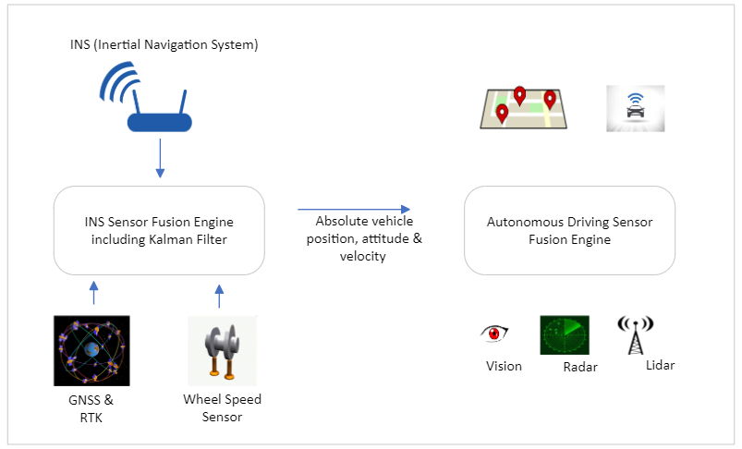
Position and Velocity Sensing
Combining Global Navigation Satellite System (GNSS) receiver technology with Inertia Navigation System (INS) to create a superior positioning solution.
INS delivers precise absolute position, velocity, time, and attitude using inertial measurement units (IMUs) and sensor data captured by the global navigation satellite system (GNSS).
An IMU makes the measurement or calculation of acceleration, linear velocity, rotational rate, relative position and attitude possible.
The IMU uses accelerometers and gyroscopes necessary for calculating changes in velocity, position, and attitude of a moving vehicle.

Slide 10
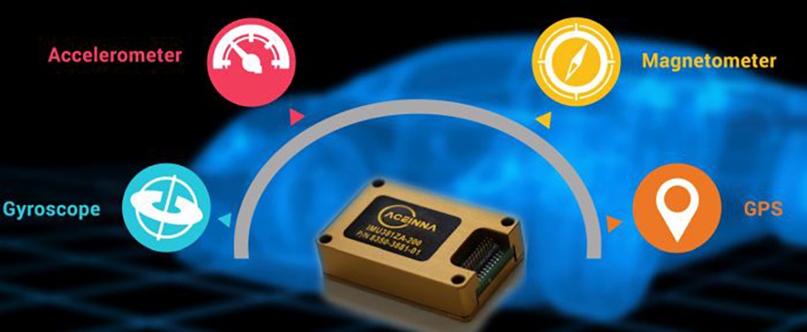
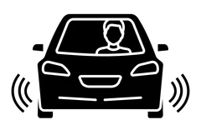
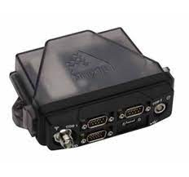
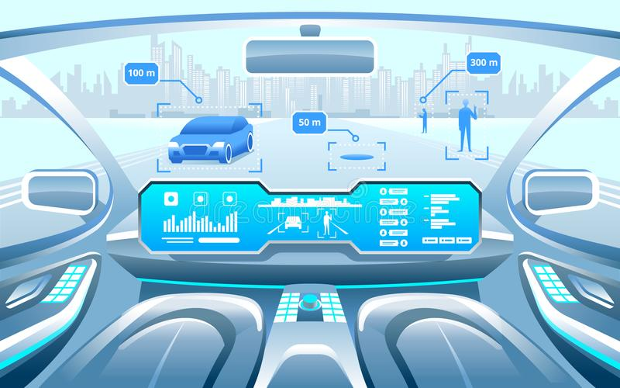
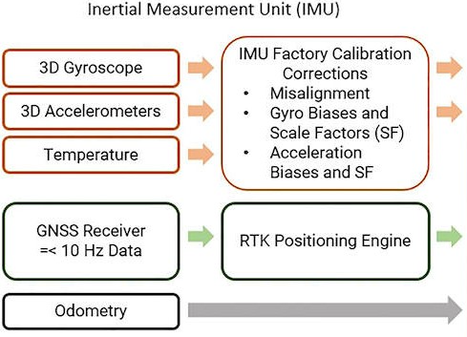
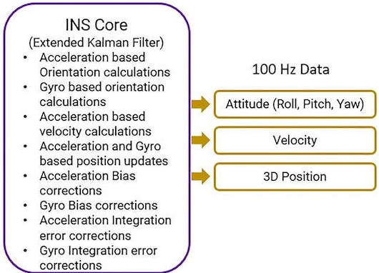
POSITION AND VELOCITY SENSING
Key Objects:
Inertial Sensors
Odometry
GPS Receiver
Digital Speedometer

Slide 11
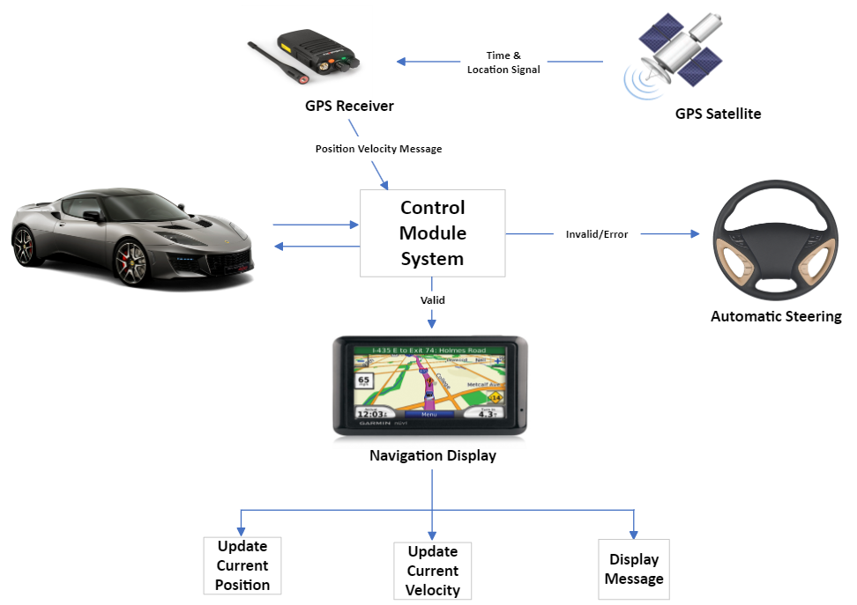
POSITION AND VELOCITY SENSING
Areas of Concern:
Absolute positioning and velocity is required to navigate the autonomous vehicle safely
Continual error correction for accurate position estimates.
Uninterrupted signals for better navigation of the system
Real-time data updates for time and location for easier vehicle operation
Precise position and speed information for autonomous steering control

Slide 12
Route Selection
Routing Message Request
Communication Module
Routing Database
Route Optimization
Route Selection
Routing Message Request
Route Optimization Module
Route Selection
Selecting Top 4
Communication Module
Sends to Steering Module
This component is responsible for determining the best available route for the vehicle to take. It considers the current position and velocity of the car and uses algorithms to determine the best route. Key objects include position and velocity sensors, road maps, traffic information, and route-planning algorithms.
The navigation and automatic steering system route selection component is designed to be extensible and scalable, allowing for the integration of additional features and functionalities. The following design patterns are used to achieve this:
Service-oriented architecture (SOA): The route selection engine is designed as a service-oriented architecture, allowing for the integration of additional services and features.
Model-view-controller (MVC): The user interface is designed using the model-view-controller pattern, allowing for the separation of the data, view, and controller components.
Publish-subscribe pattern: The route selection engine uses a publish-subscribe pattern to communicate with external services, such as weather, traffic, and terrain information.

Slide 13
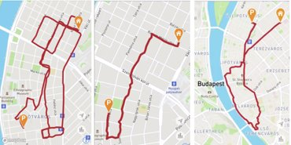
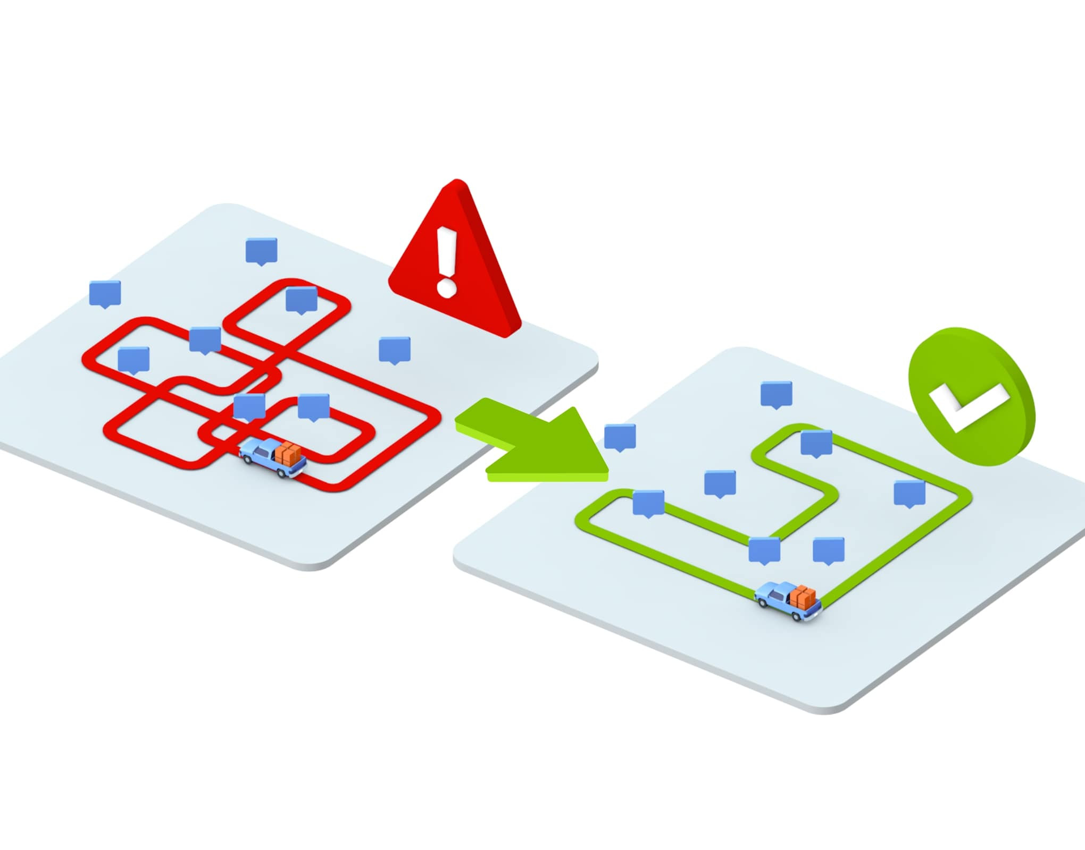
Route Selection Key Objects
Route Database: The Route Database is implemented using a relational database. It stores information such as the start and end points, the distance between the points, the time required to travel between the points, and any other factors that may influence route selection.
Route Optimization Module: The Route Optimization Module is implemented using an algorithm that considers factors such as the current position of the vehicle, the destination, and any other factors that may influence route selection.
Route Selection Module: The Route Selection Module is implemented using an algorithm that considers the current position of the vehicle, the destination, and any other factors that may influence route selection. The route selection engine is implemented as a service-oriented architecture. It is designed to be scalable and extensible, allowing for the integration of additional services and features. The route selection engine is responsible for computing the optimal route based on the user input. It also communicates with external services, such as weather, traffic, and terrain information, to provide the most accurate route possible.
Communication Module: The Communication Module is implemented using a message-passing system. It sends instructions to the Vehicle Tracking Component and Driver Assistance Component.

Slide 14
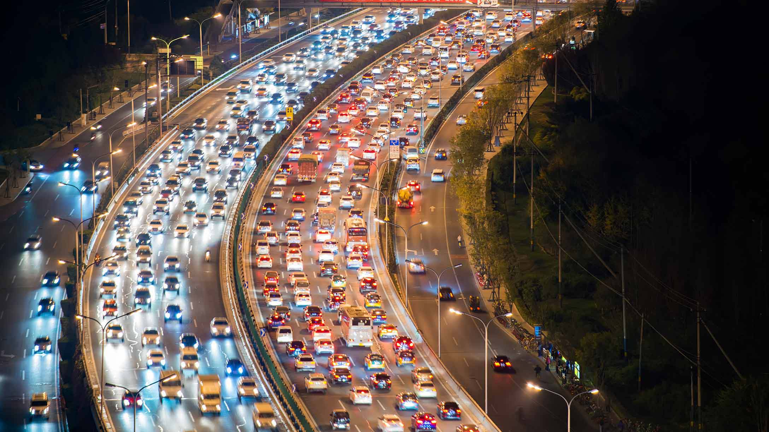

Route Selection Areas of concern
Accurate route calculation: The route selection module must be able to accurately calculate the shortest and safest route to the destination.
Avoidance of obstacles: The route selection module must be able to detect and avoid obstacles along the route.
Traffic congestion control: The system must be able to anticipate, monitor and adjust the route in order to avoid traffic congestion.
Real-time updates: The system must be able to receive and process real-time updates on traffic, road closures, and other events that could affect the route.
Smooth navigation: The system must be able to provide smooth navigation by adjusting the route based on the vehicle’s speed and other conditions.
User preferences: The system must be able to take into account user preferences such as avoiding tolls, highways, or certain roads.

Slide 15
Route Selection
Route Database and Optimization External Service
Google Maps API: Google Maps API enables developers to embed Google Maps into their web applications. The API is available in version 3.
OpenStreetMap API: OpenStreetMap API is a free and open API that enables developers to access and edit geospatial data. The API is available in version 0.6.
HERE Maps API: HERE Maps API enables developers to embed HERE Maps into their web applications. The API is available in version 3.
MapQuest API: MapQuest API enables developers to access and use MapQuest services. The API is available in version 4.
TomTom Maps API: TomTom Maps API enables developers to embed TomTom Maps into their web applications. The API is available in version 5.

Slide 16
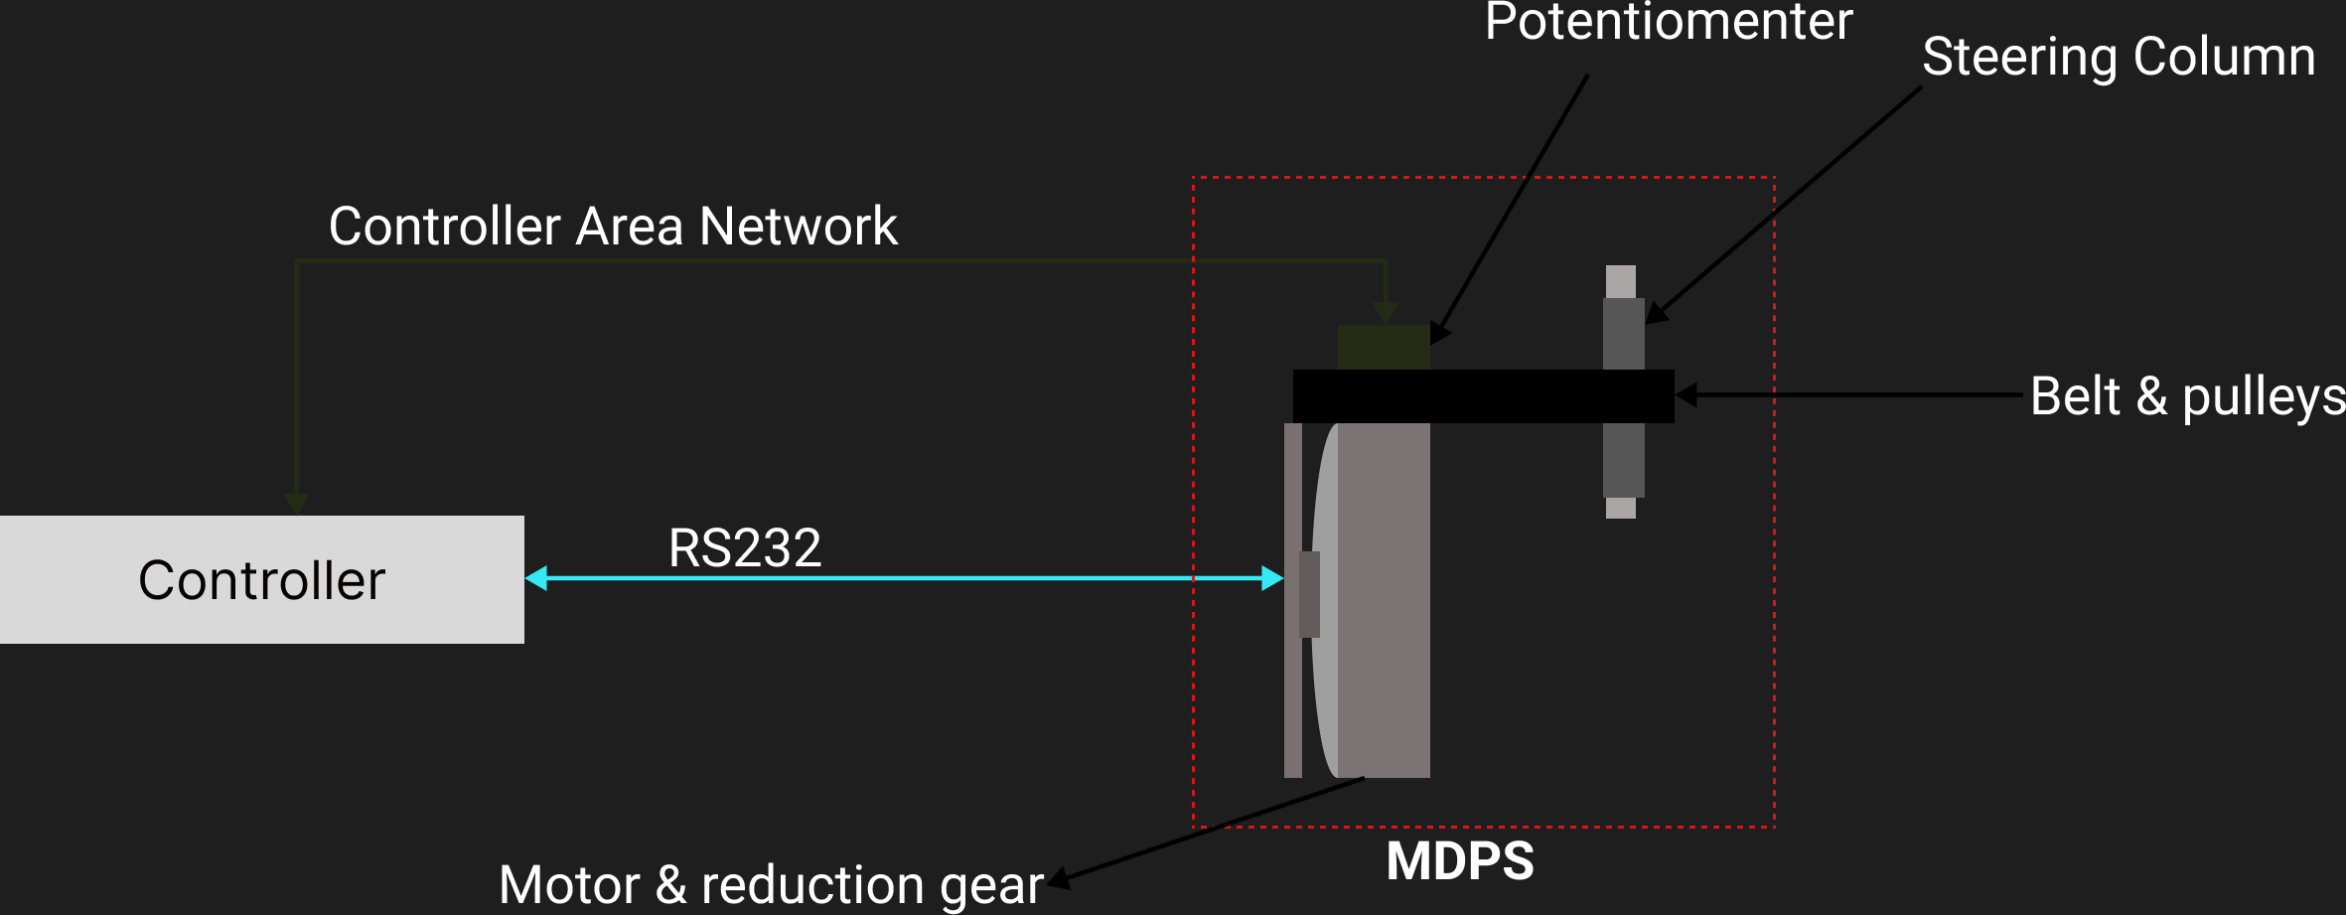
Steering Description :
Th majority of automobiles have an MDPS system for the steering.
A driver's effort is decreased by an MDPS system by using an electric motor to provide aid torque and return torque.
The steering handle can be controlled by mounting actuators and reduction gear on the steering column. Actuators transmit the torque using belt and pulley.
A potentiometer is placed on the motor shaft to measure the motor position.
The actuators and the potentiometer communicate with the control module using RS232.

Slide 17
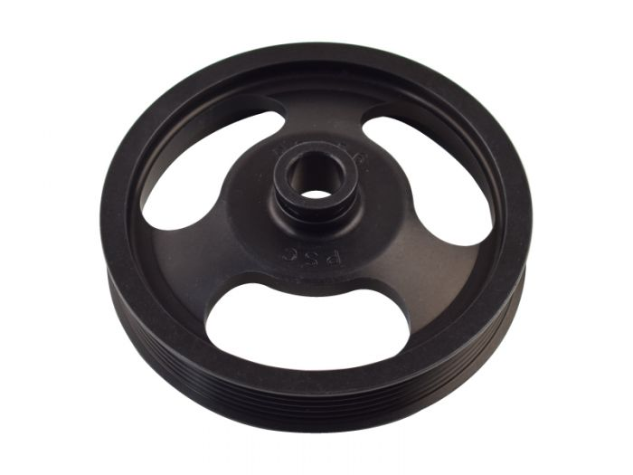
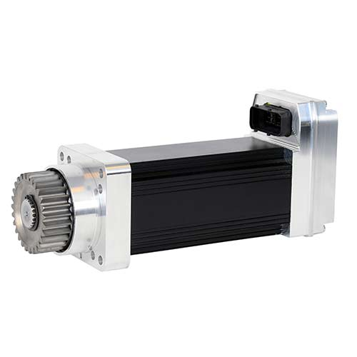
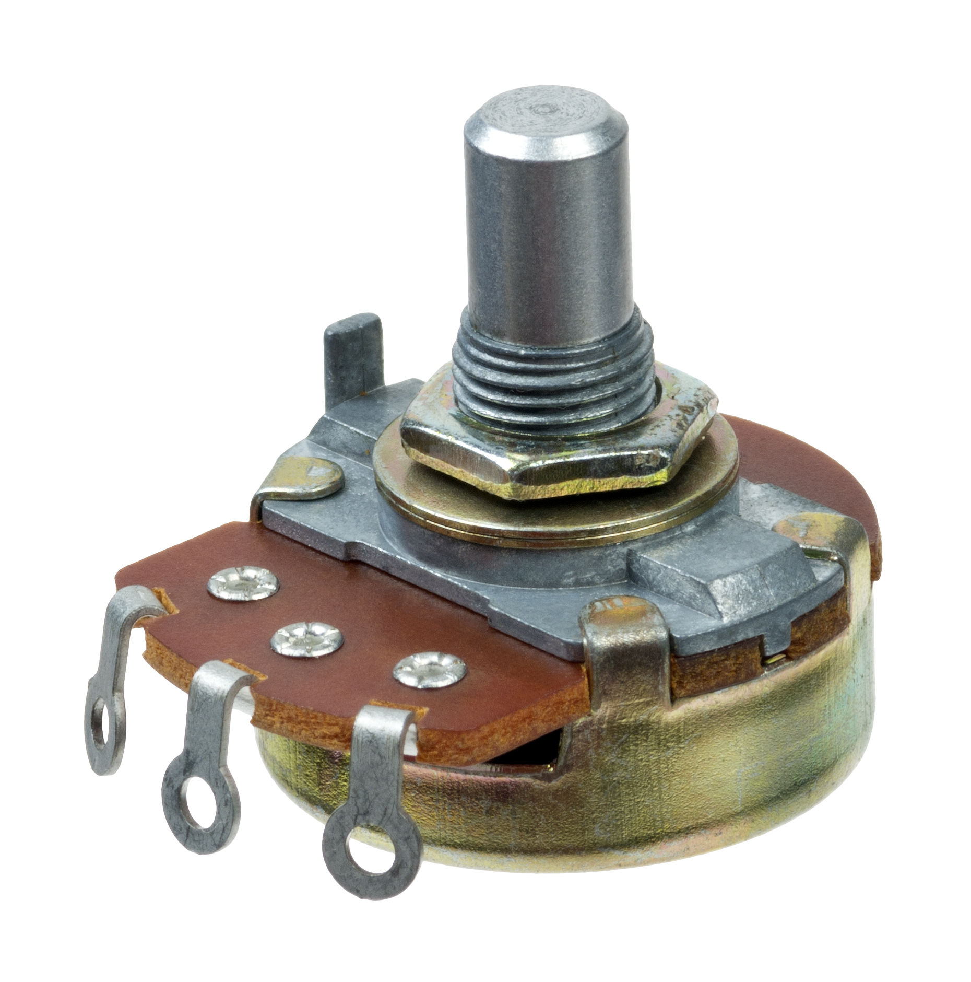
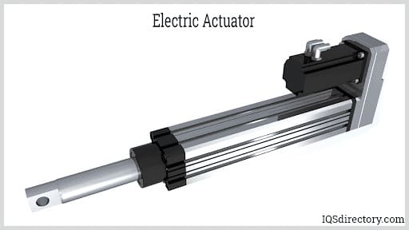
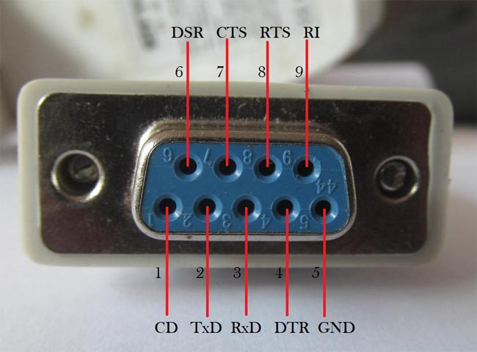
Steering Key Objects
Motor
Belt and pulley
Actuators
Potentiometer
Steering Handle
RS232

Slide 18
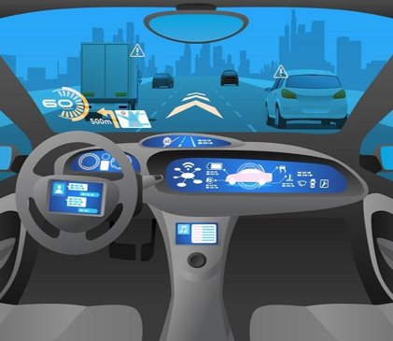
Steering Area of concern
There is a serious issue of slipping rolling of car due to oversteer and understeer.
When the road is elevated and curved there is a concern of car going out of control due to centrifugal force.

Slide 19
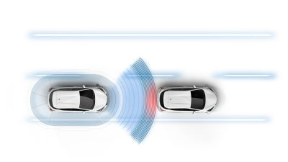
OBSTACLE AVOIDANCE
This component is responsible for detecting and avoiding obstacles in the environment. It uses radars and camera to detect obstacles in the environment and then sends commands to the steering actuator and speed control system to navigate around them

Slide 20
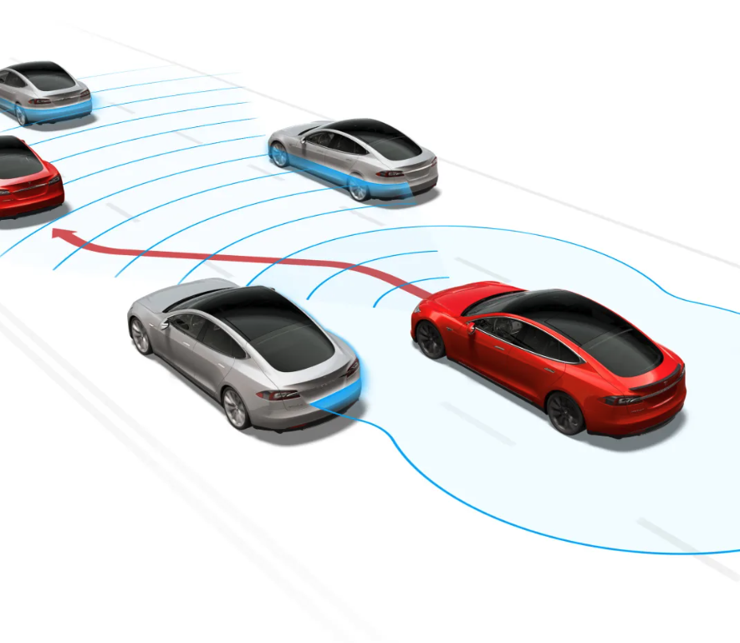
OBSTACLE AVOIDANCE
Description:
The system continuously receive Obstacle Position Message from the Obstacle Detection Component to check for potential obstacles in the vehicle's path.
The system will adjust the vehicle's speed and steering actuator in response to the demands of its current environment and situation based on the Obstacle Position Message.
The system must return complete control of the vehicle to the driver when there is an unavoidable obstacle.

Slide 21
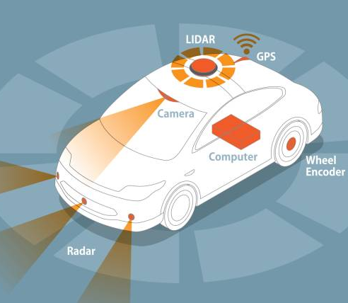
OBSTACLE AVOIDANCE
Key Objects:
Radars
To ensure high resolution in obstacle detection and accuracy in position and movement determination.
Camera
To capture images of road scenes and then turn them into a 360-degree panoramic view.
Actuators & Speed Control System
To control the vehicle's direction and speed.
Control Algorithms
Generate appropriate responses for the vehicle.

Slide 22
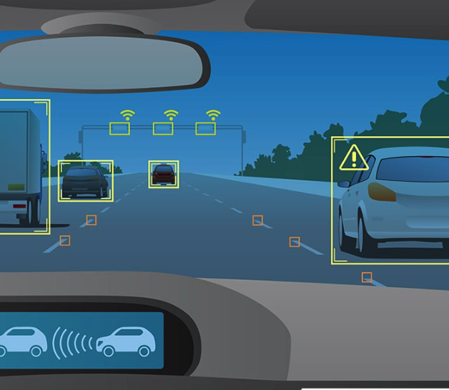
OBSTACLE AVOIDANCE
Areas of Concerns:
The vehicle might not be able to safely alter its speed and do maneuvers that call for obstacle avoidance if the system speed controller is malfunctioning.
The steering actuator may be damaged, making it impossible for the system to steer the car around obstacles.
Radars and cameras may not function properly, which would cause the system to calculate the appropriate responses incorrectly.

Slide 23
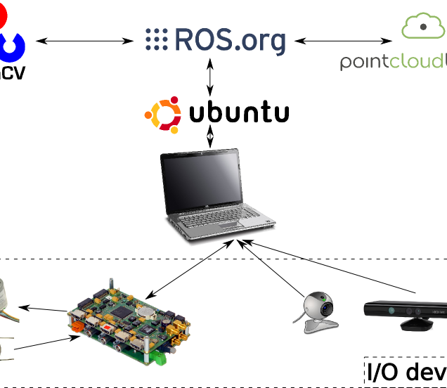
OBSTACLE AVOIDANCE
The module will run under Linux operating system as a standalone process to accelerate execution speed.
The system will communicate to other components via Publish/Subscribe pattern (messages).
Specialized image sensors that can detect light spectrum reflected from objects.
Frequency-Modulated Continuous-Wave (FMCW) radar high precision of object movement determination.

Slide 24
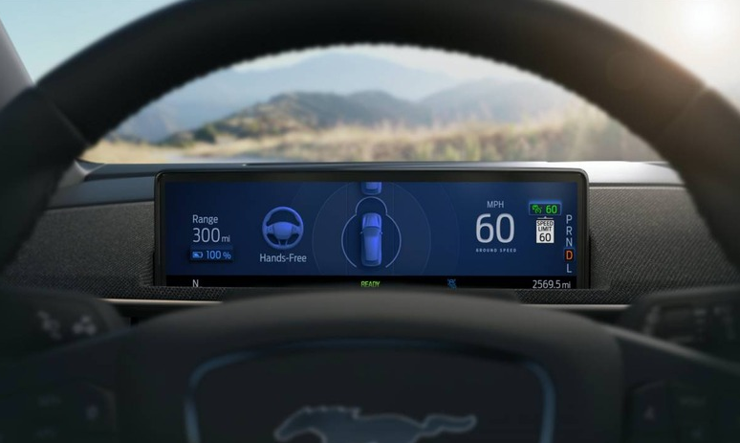
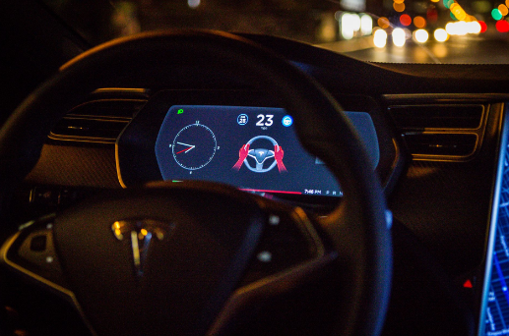
Emergency Actions
This component is responsible for detecting and responding to emergency situations. It considers the state of the Navigation and Steering System to determine if an error is present and the state of the Steering Actuators to determine if automatic steering is suspended, as well as notifying the driver through an interface. Key objects include the On-Board Diagnostics (OBD-II system), driver dashboard interface, and steering actuators.

Slide 25
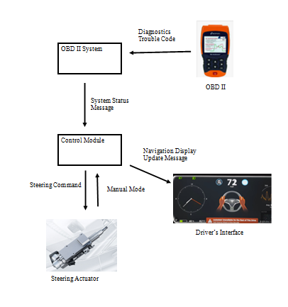
EMERGENCY ACTIONS
Description :
Most automotives require to have an OBD II Systems in their vehicles
OBD II System constantly scans the automatic steering and components throughout the vehicle for potential errors and output Diagnostic Trouble Codes
Steering actuators transition will cease automatic steering case of an error
Vehicle software notifies driver dashboard of manual steering or when automatic steering is ceased

Slide 26
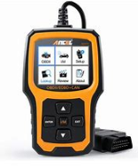
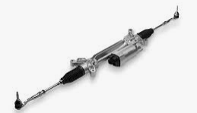
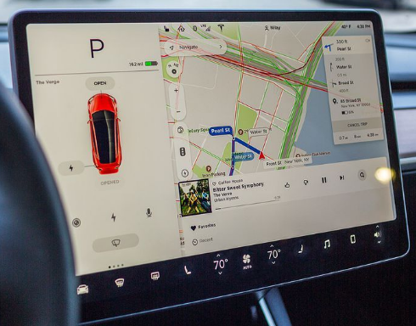
EMERGENCY ACTIONS
Key Objects:
OBD II System
Sends Diagnostics Trouble Code
Steering Actuator
Assists in automatic steering using pressure to convert energy (hydraulic/ electrical ) to mechanical force
Driver Dashboard Display
Notifies driver of status of automatic steering / manual mode

Slide 27
EMERGENCY ACTIONS
Areas of Concerns:
OBD II System may send wrong trouble codes or may not send any trouble codes at all
Broken components of the steering actuator may e concern of automatic steering. In Which Emergency actions should take care.
The emergency action will require a velocity & position or, if its not working as expected then emergency action cant be t is taken.

Slide 28
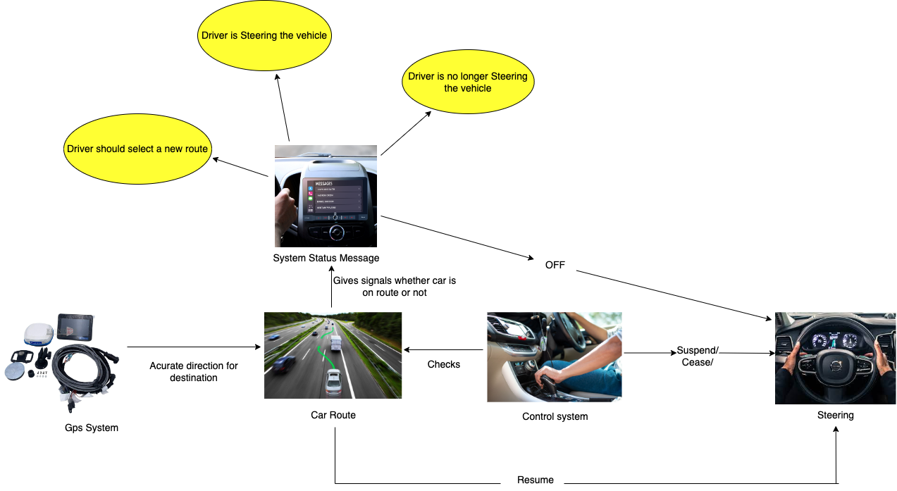
DRIVER CONTROLS
Description:
This component is responsible for providing the driver with the necessary controls to operate the vehicle. It includes the steering wheel, GPS system, and display panel for the operation to take place. When the system should switch between the manual and the automatic is performed by the driver controls. It gives instructions to resume or suspend the steering machine.

Slide 29
Driver controls KEY OBJECTS
Steering Wheel Angle Sensor: This sensor monitors the angle of the steering wheel and sends feedback to the DCM, which adjusts the speed of the vehicle and its direction.
GPS Module: This module provides positional data to the DCM from global positioning satellites, which can be used to guide the vehicle through a given route.
Display Pannel: It displays all the status of the activities going on in the car system and informs the driver through the updates.

Slide 30
Driver controls AREAS OF CONCERN
The system should be well designed in such a way that the switching between Manual mode to automatic and automatic to manual should be done with ease and not causing problem for the user.
The Display integrated should be very fast for displaying the messages and should be taken care of that the glitch does not occur while the message is being portrayed.
If the car's system will not detect that the car is on the perfect route despite of not being on the route can cause accidents at that time , if the user selects the automatic mode.

Slide 31
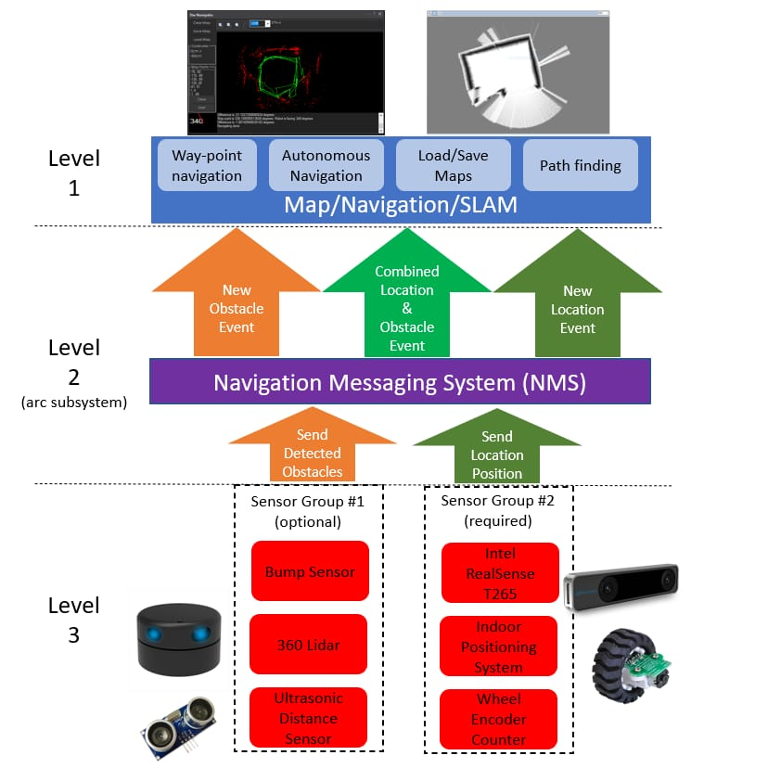
Diagnostic Information Generation
Description :
This component is responsible for generating diagnostic information about the vehicle and its components. It collects data from the various components and then analyzes it to generate reports. Key objects include the sensors, control algorithms, and diagnostic software.
The Navigation Messaging System (NMS) is built into the ARC framework.
It allows skills to push data (location & obstacle detection) into the messaging system. Then, mapping/navigation SLAM skills can subscribe to the navigation events. The NMS was designed to provide transparent Navigation to the user in ARC

Slide 32
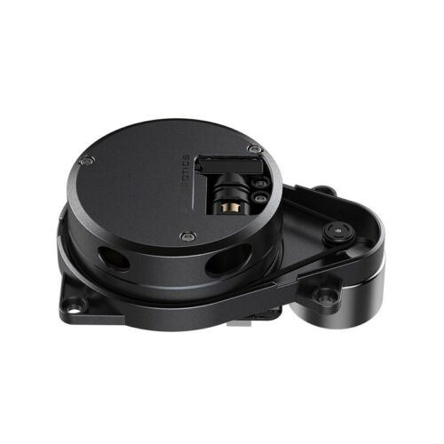
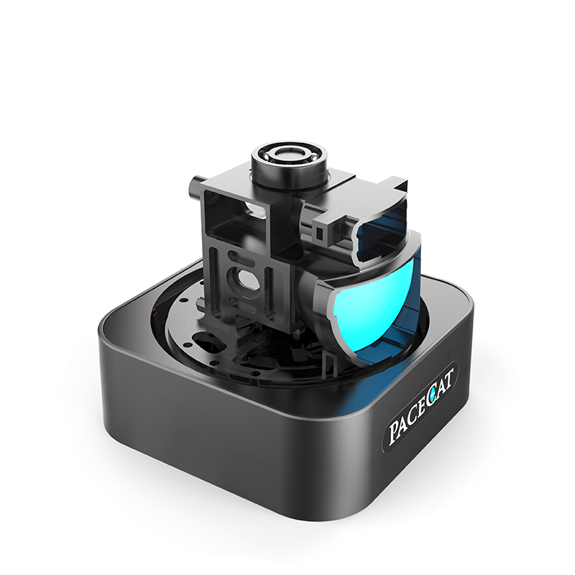
DIAGNOSTIC INFORMATION GENERATION
Key Objects:
There are two sensor groups
Group1-> Bump Sensor,360 Lidar Sensor, Ultrasonic diagnostic sensor
Group2-> Intel Real Sense T265,Indoor Positioning System, Wheel Endurance

Slide 33
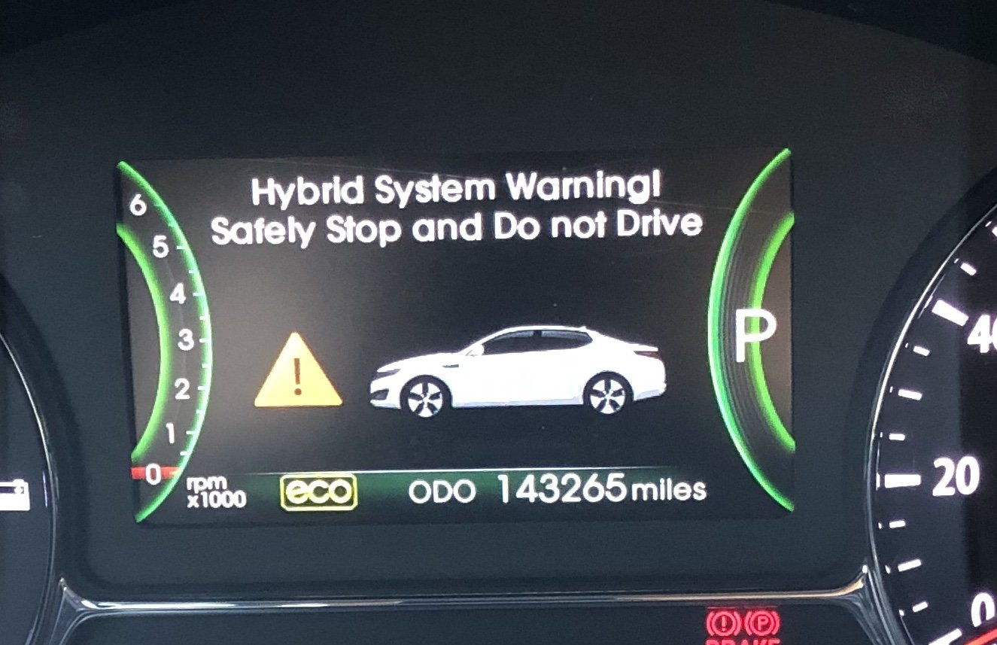
DIAGNOSTIC INFORMATION GENERATION
Areas of Concern
One or more System Status Messages shall be generated indicating the reason that automatic steering has ceased.
The Navigation system has to generate the message when ceased with the relevant ceased message.
The Navigation system should not accept any massages from routing component until restarted of the vehicle has been ceased.

Slide 34
Most important component in the design & Why
Controller:
It’s the main control unit of the product. It has control of the whole product. It’s the central processing unit.
In Architecture, the Controller is planned using intel sky lake ration based architecture.
Position & Velocity:
Position & Velocity component has important LIDAR, CAMERA sensor which is essential for the entire product.
It works closely with most of the all other components like OBDII, Controller, Steering.
Steering:
Steering is one of the most important components in the design since, navigation cannot act without it.
The steering also closely interacts with other components, it can help user or driver to take over when there is an emergency or unavoidable situation.

Slide 35
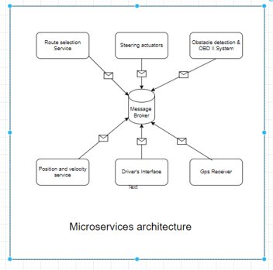
Most important component in the design & Why
Emergency Actions
Emergency action is also an important component, when there is a unavoidable circumstances arises during the navigation or auto steering, there could be a SOS call might get required.
Emergency action module which is OBD, which need to notify the driver to take over the steering when there is an obstacle is found which is not visible in the sensor at the expected interval.
Thus, its important to avoid collision or impact.. :

Slide 36
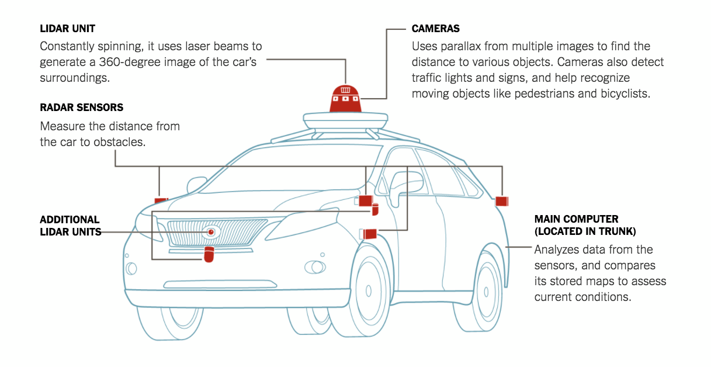
Most important component in the design & Why
Sensors: Sensors are one of the most important components of a navigation and automatic steering system. They are responsible for gathering data from the environment and providing the necessary information for the system to take action. Without sensors, the system would not be able to determine its location, heading, speed and other vital information.
Control Unit: The control unit is the brain of the system and is responsible for interpreting the data from the sensors and making decisions. It also manages the motors, servos and other components of the system, sending commands to them to perform specific actions. Without the control unit, the system would not be able to make decisions or control the motors and servos.
Motors and Servos: Motors and servos are responsible for moving the vehicle in response to the commands from the control unit. Without them, the system would not be able to move the vehicle or steer it in the right direction.
These components are all essential for a navigation and automatic steering system to function properly. Without them, the system would not be able to interpret data from the environment, make decisions or control the vehicle’s motion

Slide 37
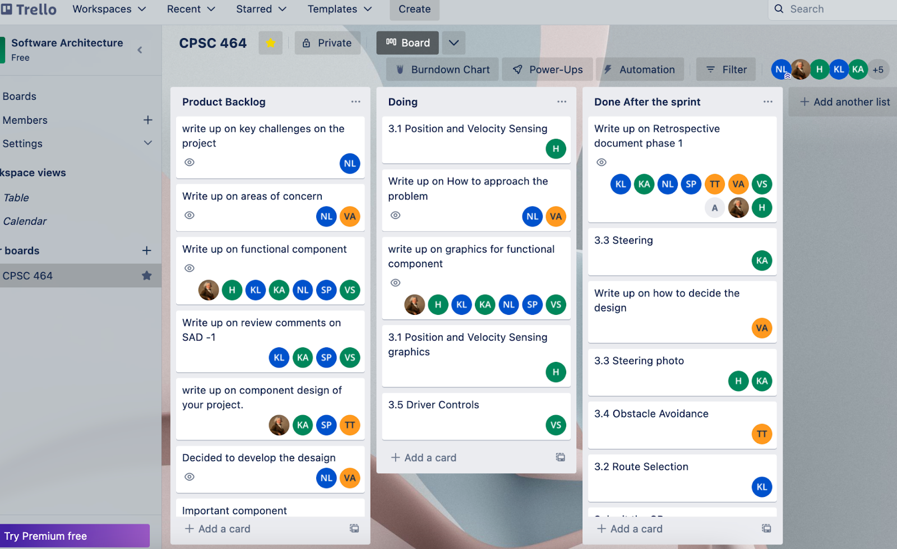
Scrum Artifact

Slide 38
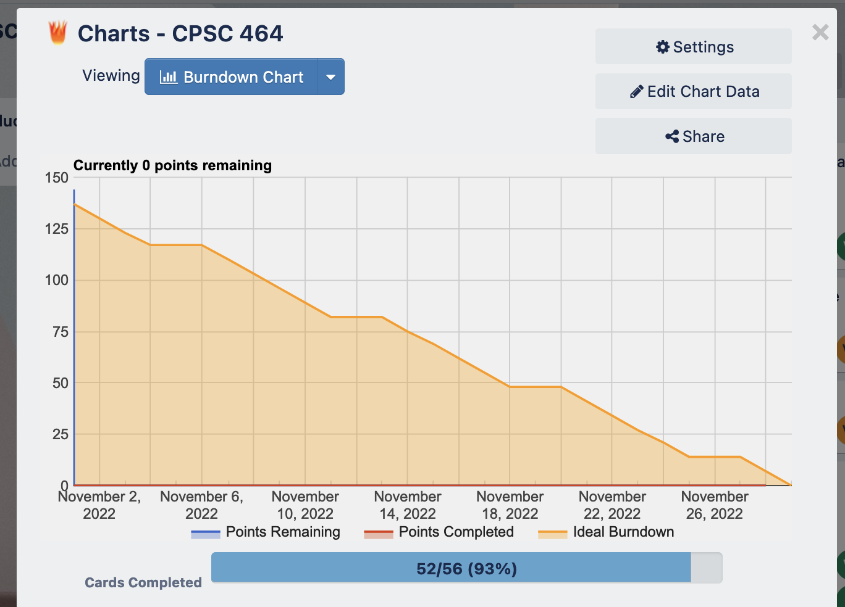
Burndown Charts

Slide 39
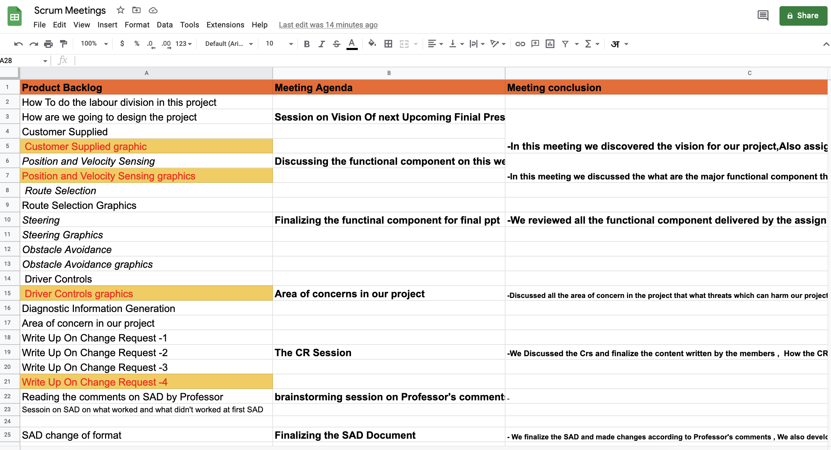
Scrum MEETINGS

Slide 40

Q&A

Slide 41
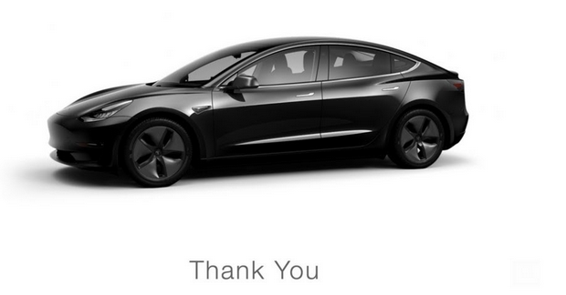

Thank you for your time

